Slide 1
Entity-Relationship Model

Slide 2
Software Development Lifecycle
Requirements Analysis: SRS
Design: Design Document
Implementation: Software/Product

Slide 3
Database Development
Problem Definition
Requirements Analysis
System Requirements Specification (SRS)
Conceptual Design (E-R, E-R to Relational, Schema Refinement)
Physical Database Design (data volume, performance criteria, tuning)
Hierarchy of users and securities
Implementation
Testing
Maintenance

Slide 4
Database Design Process (1)
Requirements Analysis
  What data?
  Categories of users
  Constraints
Conceptual Design
  High level description of data
  Entity-Relationship model can be used
Logical Design
  E-R to Relational Mapping
Schema Refinement
  Analyze collection of relations
  Identify potential problems
  Normalization

Slide 5
Database Design Process (2)
Physical Database Design
  Database load
  Performance criteria
  Building indexes on tables
  Clustering tables
  Database tuning
Application and Security Design
  Hierarchy of users and access
  The complete design requires tuning where all these steps are interleaved and repeated until design is acceptable

Slide 6
Requirements Analysis
What data is to be stored in the database?
What users want from the system?
Frequent queries, performance requirements (functional/ non-functional)
Discussions with potential users, study of the existing system, study of the available documents, questionnaire
The output is SRS
Well documented using the appropriate templates

Slide 7
Conceptual Database Design
The information gathered in the analysis step is used to develop a high-level description of the data to be stored in the database, along with the constraints
E-R model can be used for this
The model creates a simple description of the data
How users think of the data, people and processes involved
This will be transformed into the data model (relational) supported by a commercial database system

Slide 8
Logical Database Design
Choose a DBMS to implement this design
Convert the conceptual design into a database schema ( convert E-R to Relational)

Slide 9
E-R Model
Conceptual design: (ER Model is used at this stage.)
  What are the entities and relationships in the enterprise?
  What information about these entities and relationships should we store in the database?
  What are the integrity constraints or business rules that hold?
  A database `schema’ in the ER Model can be represented pictorially (ER diagrams)
  Can map an ER diagram into a relational schema

Slide 10
Visual Model: Diagram
Visual modeling is graphical representation of ‘things’ belonging to the domain of interest
It shows relationships among these things
Graphical language
Ex: E-R Model, UML, SysML, Visual OWL, IDEF ( Intergration DEFinition)

Slide 11
E-R Model Basics
Entity: Real-world object distinguishable from other objects. An entity is described (in DB) using a set of attributes.
Example: specific employee, specific college
Entity Set: A collection of similar entities sharing similar properties. E.g., all employees.
  All entities in an entity set have the same set of attributes. Each entity set has a key.
  Each attribute has a domain.

Slide 12
Entities, Relationships, Attributes (1)
Entities
  Anything real or abstract belonging to domain of interest
  Roles, events, locations, tangible things or concepts, people
  Faculty, payment, campus, book, timetable, discussions
Relationships
  A data relationship is natural association that exists between entities
  Ex: faculty teaches courses
  Cardinality defines number of occurrences of one entity for the single occurrence of another entity
  A faculty teaches one or two courses per semester

Slide 13
Entities, Relationships, Attributes (2)
  A data attribute is a characteristic of an entity
  Property, data element, field, attribute
  Ex: Student (name, IDNo, course credit)
  Domain
  Atomic (simple) vs. Composite
  Single-valued vs. Multi-valued
  Derived
  Course Credit, Name consists of (first name, middle name, last name)
  List of course enrolled into, CPI
  Date of birth, age

Slide 14
Keys (1)
Superkey (SK)
  Set of one or more attributes which taken collectively identifies uniquely an entity in entity set
  Ex: Student ( student name, IDNo, CPI, program, address)
  Student entity set superkey can be (student name, IDNo)
  Superkey may contain extraneous attributes
  There can be more than one superkeys
Candidate Key (CK)
  A superkey for which no subset is a superkey
  Ex: IDNo is a Candidate Key as it is minimal and uniquely identifies a student from Student Entity Set
  There can be more than one candidate keys

Slide 15
Keys(2)
Primary Key (PK)
  Is a candidate key
  One of the candidate key is chosen by database designer as a primary key
Example
  Telephone Book( STD Code, Telephone number, Name, Address)
  Composite Key

Slide 16
Degree of a relationship set
Indicates number of associated entity sets
  Binary
  Ternary
  Quaternary …
Unary - Recursive relationships

Slide 17
Contd.
Choice of attributes reflects the level of information details for that entity
Schema: Employee ( name, ssn, address, age, gender)
Each attribute has a domain of possible values
  Example: name of Employee might be the set of 25-character string
Key: A minimal set of attributes whose values uniquely identify an entity in the set
Candidate Key: There could be more than one candidate key
Primary Key: One of the candidate key is designated as a primary key

Slide 18
E-R Model Elements
Entity Set: rectangle
Attribute: oval
Relationship: diamond
Each attribute in the primary key is underlined
The domain information could be listed along with the attribute name, but can be omitted for compactness
name
ssn
lot
Employees

Slide 19
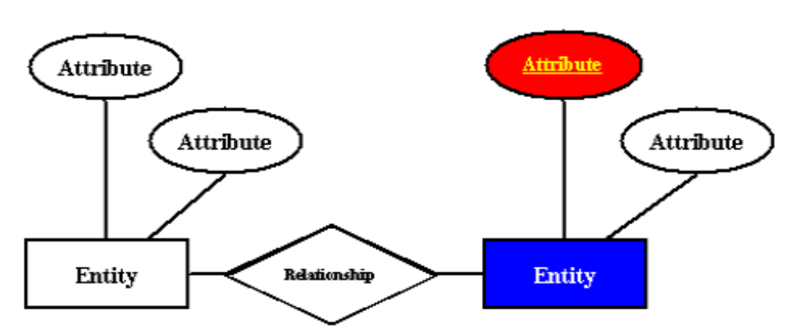
E-R Diagram

Slide 20
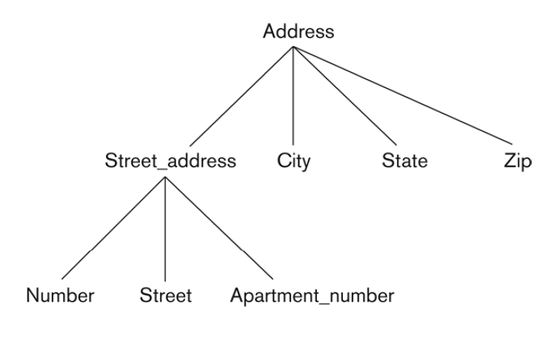
Composite Attribute

Slide 21
E-R Model Basics (1)
  Relationships can have their own attributes
  Descriptive Attributes
  Binary relationship

Slide 22
ER Model Basics (2)
name
ssn
lot
since
Employees
name
dname
super-visor
subor-dinate
ssn
lot
did
budget
Works_In
Reports_To
Employees
Departments
Relationship: Association among two or more entities. E.g., Rajendra works in research & development department.
Relationship Set: Collection of similar relationships.
  An n-ary relationship set R relates n entity sets E1 ... En; each relationship in R involves entities e1 € E1, ..., en € En
    Same entity set could participate in different relationship sets, or in different “roles” in same set.

Slide 23
E-R Model Basics (3)
Consider Works_In: An employee can work in many departments; a dept can have many employees
Works-In can have descriptive attribute ‘since’
A relationship must be uniquely identified by the participating entities without reference to the descriptive attributes
  Each works_in uniquely identified by the combination of employee ssn and department did
  For given employee-dept pair we have only one ‘since’ value
In contrast, each dept has at most one manager, although a single employee can manage more than one department, according to the key constraint on Manages.

Slide 24
Key Constraints
since
name
dname
ssn
lot
did
budget
Employees
Manages
Departments
An employee can work in many departments; a dept can have many employees.
Works_In
since
In contrast, each dept has at most one manager, according to the key constraint on Manages.
Many-to-Many
1-to Many
1-to-1
Notes:
6

Slide 25
Constraints
Connectivity – the number of possible occurrences of an entity set that may relate to a single occurrence of an associated entity set through a particular relationship
  One-to-one
  One-to-many
  Many-to-many

Slide 26
Connectivity for Complex Relationships
Complex relationships are relationships of degree 3 or higher
Connectivity – the number of possible occurrences of an entity set in an n-ary relationship when the other (n-1) values of participants are fixed

Slide 27
Cardinality of a Relationship Set
Describes the maximum number of possible relationship occurrences for an entity set participating in a given relationship set

Slide 28
Key Constraints
since
name
dname
ssn
lot
did
budget
Employees
Manages
Departments
Approach 1
Approach 2
CREATE TABLE Manages(
ssn CHAR(11),
did INTEGER,
since DATE,
PRIMARY KEY (did),
FOREIGN KEY (ssn) REFERENCES Employees,
FOREIGN KEY (did) REFERENCES Departments)
CREATE TABLE Dept_Mgr(
did INTEGER,
dname CHAR(20),
budget REAL,
mgr_ssn CHAR(11),
since DATE,
PRIMARY KEY (did),
FOREIGN KEY (ssn)
REFERENCES Employees)
NOT NULL
NOT NULL
Notes:
6

Slide 29
Participation Constraints (1)
Does every department have a manager?
  If so, this is a participation constraint: the participation of Departments in Manages is said to be total (vs. partial).
    Every Departments entity must appear in an instance of the Manages relationship.
since
since
name
name
dname
dname
ssn
did
did
budget
lot
budget
Employees
Manages
Departments
Works_In
Means: “exactly one”
since
Notes:
8

Slide 30
Participation Constraints (2)
How to enforce total participation of Employees & Departments in Works_in?
Every did value appearing in Departments appears in a tuple of Works_in.
FK from Departments/Employees to Works_in?

Slide 31
E-R Model: Notation
Peter Chen Notation (US) 1976 *
Crow’s Foot Notation (UK) (Bachman)
  Range of cardinalities can’t be depicted (need data dictionary)
IDEF1X Model
  weak entity set depiction is a problem
All deal with concepts
  entities, relationships, attributes, connectivity, cardinality

Slide 32
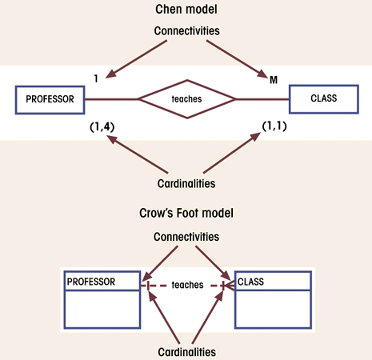
Cardinality in an ERD

Slide 33
Weak Entities (1)
we assumed that an entity set always has a key, but this is not true
A weak entity can be identified uniquely by considering some of its attributes in conjunction with the primary key of another entity( identifying owner)
Example: employees can purchase insurance policies to cover their dependents. To record information about policy including who is covered by each policy. In this case if an employee quits, any policy owned by him/her is terminated and we want to delete all the relevant policy and dependent information from the database

Slide 34
Weak Entities (2)
A weak entity can be identified uniquely only by considering the primary key of another (owner) entity.
  Owner entity set and weak entity set must participate in a one-to-many relationship set (one owner, many weak entities).
  Weak entity set must have total participation in this identifying relationship set.
  pname is a partial key of weak entity set (dashed underline)
name
ssn
lot
cost
pname
age
Employees
Policy
Dependents
Notes:
10

Slide 35
Need of Weak Entities
Don’t overuse weak entity set
The usual reason is that there is no global authority capable of creating unique ID’s.
Example: it is unlikely that there could be an agreement to assign unique player numbers across all football teams in the world.
we almost always create unique ID's to compensate: social-security numbers
The only times weak E.S.'s seem necessary are when:
  We can't easily create such ID's; e.g., no one is going to accept a “species ID” as part of the standard nomenclature
  There is no global authority to create them

Slide 36
ISA (`is a’) Hierarchies (1)
name
ssn
lot
Employees
hourly_wages
hours_worked
ISA
Attributes are inherited.
If we declare A ISA B, every A entity is also considered to be a B entity.
contractid
Hourly_Emps
Contract_Emps
Employees are SPECIALIZED into subclasses
Identifying subsets of an entity set that share some distinguishing characteristic
Hourly_emps & Contract_emps are GENERALIZED by Employees
Notes:
12

Slide 37
ISA (`is a’) Hierarchies (2)
Overlap constraints: Can Megha be an Hourly_Emps as well as a Contract_Emps entity? (Allowed/disallowed)
No overlap is Default
Hourly employee OVERLAPS contract employee
Covering constraints: Does every Employees entity also have to be an Hourly_Emps or a Contract_Emps entity? (Yes/no)
No covering is Default
Hourly employee AND Contract employee COVER Employee

Slide 38
ISA (`is a’) Hierarchies (3)
2 basic reasons for identifying subclasses (by specialization or generalization):
  We want to add descriptive attributes that apply only to entities in a subclass
  Identify the set of entities that participate in some relationship for eg. Only senior employees could be mangers
  Want to add few more categories/subclasses in future

Slide 39
Review: Basic ER Model
Entities and Entity Set (boxes)
Relationships and Relationship sets (diamonds)
  binary
  n-ary
Key constraints (1-1,1-M, M-M, arrows on 1 side)
Participation constraints (bold for Total)
Weak entities - require strong entity for key
Aggregation - an alternative to n-ary relationships
ISA hierarchies - abstraction and inheritance

